Slide 1




Slide 2

TEST TIME ON SIMPLE SIEVE
URL:https://forms.gle/rfiS4B5bPgnaRVgg6
QR CODE:

Slide 3

SEGMENTED SIEVE
AND
INCREMENTAL SIEVE

Slide 4


TOPICS
Introduction Of Segmented Sieve
Algorithm
Advantage
Example
Program
Introduction Of Incremental Sieve
Interview Questions

Slide 5
Segmented Sieve
INTRODUCTION
A segmented sieve, also known as a segmented version of the Sieve of Eratosthenes, is a way to find all prime numbers within a range of numbers, rather than all prime numbers up to a certain number.
It is an efficient algorithm for generating prime numbers within a specific range.
The basic idea behind the segmented sieve is to divide the range of numbers into segments and apply the Sieve of Eratosthenes to each segment.
In Simple Sieve, we needed O(n) space which may not be feasible for large n.
Here we need O(√n) space and we process smaller ranges at a time (locality of reference)

Slide 6
Algorithm
The algorithm works as follows:
Create a list of all numbers in the given range, and mark all numbers as prime.
Find the prime numbers up to the square root of the upper bound of the range using the traditional Sieve of Eratosthenes.
For each prime number found in step 2, mark all multiples of that prime as non-prime in the list created in step 1.
The remaining numbers in the list are the prime numbers within the given range.

Slide 7
ADVANTAGE
Segmented sieve is more memory efficient than the traditional sieve, as it only needs to store the primes within a specific range, rather than all primes up to a certain number.
This makes it well-suited for problems where large ranges of numbers need to be searched for primes.
It’s worth noting that a Segmented sieve is faster than the traditional sieve when the range of numbers is large.
It's also useful for finding primes in large intervals as it takes less memory space.

Slide 8
Example: Find the prime numbers in the range of 80 and 90
Create a simple sieve of 10^6
Generate the primes till sqrt(high) i.e sqrt(90) = 9.48 ⋍ 9
Store the prime number in a arraylist i.e al = [2,3,5,7]
Create a boolean array of size high - low + 1 i.e 90 - 80 + 1 = 11
Initialize all its value as true
0 | 1 | 2 | 3 | 4 | 5 | 6 | 7 | 8 | 9 | 10
true | true | true | true | true | true | true | true | true | true | true
80 | 81 | 82 | 83 | 84 | 85 | 86 | 87 | 88 | 89 | 90

Slide 9
Example: Find the prime numbers in the range of 80 and 90
6. Take the first multiple of the first prime in arraylist. i.e. The first multiple of 2 in the given range is 80. Starting from 80 mark all the multiples of 2 as false.
2
0 | 1 | 2 | 3 | 4 | 5 | 6 | 7 | 8 | 9 | 10
false | true | false | true | false | true | false | true | false | true | false
80 | 81 | 82 | 83 | 84 | 85 | 86 | 87 | 88 | 89 | 90

Slide 10
Example: Find the prime numbers in the range of 80 and 90
7. Repeat the same steps for other prime numbers available in the arraylist.
3
0 | 1 | 2 | 3 | 4 | 5 | 6 | 7 | 8 | 9 | 10
false | false | false | true | false | true | false | false | false | true | false
80 | 81 | 82 | 83 | 84 | 85 | 86 | 87 | 88 | 89 | 90

Slide 11
Example: Find the prime numbers in the range of 80 and 90
5
0 | 1 | 2 | 3 | 4 | 5 | 6 | 7 | 8 | 9 | 10
false | false | false | true | false | false | false | false | false | true | false
80 | 81 | 82 | 83 | 84 | 85 | 86 | 87 | 88 | 89 | 90

Slide 12
Example: Find the prime numbers in the range of 80 and 90
7
0 | 1 | 2 | 3 | 4 | 5 | 6 | 7 | 8 | 9 | 10
false | false | false | true | false | false | false | false | false | true | false
80 | 81 | 82 | 83 | 84 | 85 | 86 | 87 | 88 | 89 | 90
8. In the end, whichever is true those numbers are prime numbers
The prime number are in the range of 80 to 90 is 83, 89

Slide 13

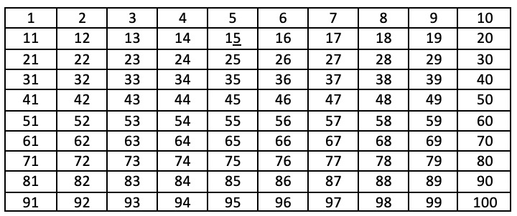
EXAMPLE: Find the prime numbers in a range from 1 to 100
Step 1:1.1.Determine the square root of the upper limit, which is 10 in this case (since 10*10 = 100).
1.2.Generate all primes up to sqrt(10) using the Sieve of Eratosthenes algorithm: 2, 3, 5, 7.
Step 2: The numbers between 1 and 100 are listed in the table below.

Slide 14
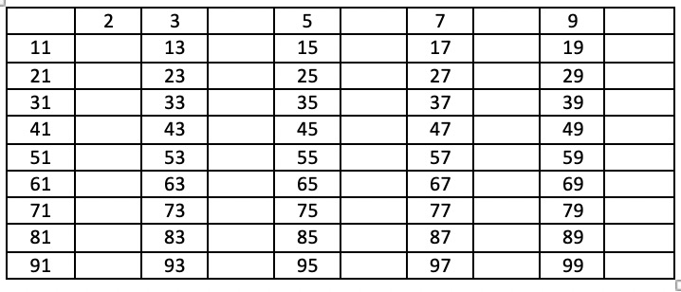
Step 3: Remove 1 because it’s not a prime number.The next step is to remove all the multiples of 2, except 2 itself.

Slide 15
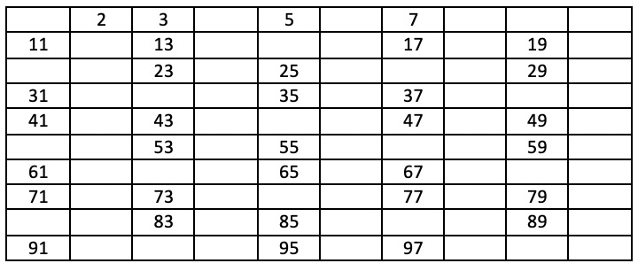
Step 4:Now remove all multiples of 3 and only leave these 3.

Slide 16
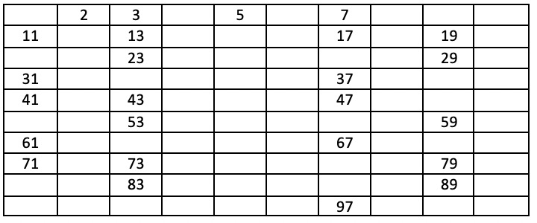
Step 5:Now remove all multiples of 5 and 7 only leave these numbers 5,7.

Slide 17
Present numbers are prime numbers and all the removed numbers are composite numbers. So, the prime numbers from 1 to 100 are:
2, 3, 5, 7, 11, 13, 17, 19, 23, 29, 31, 37, 41, 43, 47, 53, 59, 61, 67, 71, 73, 79, 83, 89, and 97

Slide 18
PROGRAM:
import java.util.*; class Main { static int N = 100000; static boolean arr[] = new boolean[N+1]; static void simpleSieve() { for(int i=2;i<=N;i++) { arr[i] = true; } for(int i=2;i<Math.sqrt(N);i++) { if(arr[i] == true) { for(int j=i*i; j<=N; j=j+i) { arr[j] = false; } } } } | static ArrayList<Integer> generatePrimes(int n) { ArrayList<Integer> al = new ArrayList(); for(int i=2;i<Math.sqrt(n);i++) { if(arr[i] == true) { al.add(i); } } return al; }
Notes:
Output
prime numbers from 1 to 25:7 11 13 17 19 23

Slide 19
PROGRAM:
public static void main (String[] args) { Scanner sc = new Scanner(System.in); int low = sc.nextInt(); //80 int high = sc.nextInt(); //90 simpleSieve(); ArrayList<Integer> al = generatePrimes(high); boolean dummy[] = new boolean[high-low+1]; for(int i=0;i<high-low+1;i++) { dummy[i] = true; } | for(int prime: al) { int firstMultiple = (low/prime) * prime; if(firstMultiple < low){ firstMultiple = firstMultiple + prime; } int start = Math.max(firstMultiple, prime*prime); for(int j=start; j<=high; j+=prime) { dummy[j-low] = false; } } for(int i=low;i<=high;i++) { if(dummy[i-low] == true) { System.out.print(i + " "); } } } }
Notes:
Output
prime numbers from 1 to 25:7 11 13 17 19 23

Slide 20
Incremental Sieve
Introduction
The standard Sieve of Eratosthenes requires that you specify an upper bound before you start
But often, programs that use prime numbers don’t know the upper bound in advance or don’t want to pre-compute and store all of the primes up to their bound.
In such cases, the Incremental Sieve algorithm can be used

Slide 21
An incremental formulation of the sieve generates primes indefinitely (i.e. without an upper bound) by interleaving the generation of primes with the generation of their multiples (so that primes can be found in gaps between the multiples), where the multiples of each prime p are generated directly, by counting up from the square of the prime in increments of p (or 2p for odd primes)
The generation must be initiated only when the prime's square is reached, to avoid adverse effects on efficiency. It can be expressed symbolically under the dataflow paradigm as
primes = [2, 3, ...] \ [[p², p²+p, ...] for p in primes]
Where \ denotes the set subtraction of arithmetic progressions of numbers.

Slide 22
Pseudocode
function incrementalSieve(limit):
primes = [2]
next_num = 3
while next_num <= limit:
is_prime = True
sqrt_next_num = sqrt(next_num)
for prime in primes:
if prime > sqrt_next_num:
break
if next_num % prime == 0:
is_prime = False
break
if is_prime:
primes.append(next_num)
for i in range(next_num * next_num, limit + 1, next_num * 2):
# Mark multiples of the new prime as composite
# Start at prime squared to avoid marking even multiples
# Increment by 2*prime to skip even multiples
is_composite[i] = True
next_num += 2
return primes

Slide 23
Here, PRIMES is a list of prime numbers generated so far, starting with 2. NEXT_NUM is the next odd number to be checked for primality.
The loop continues until NEXT_NUM reaches the limit.
For each NEXT_NUM, the algorithm checks whether it is divisible by any of the primes in the primes list up to its square root.
If NEXT_NUM is found to be composite, the algorithm moves on to the next odd number. Otherwise, NEXT_NUM is added to the primes list and its multiples are marked as a composite in a BOOLEAN array IS_COMPOSITE.
Finally, the algorithm increments NEXT_NUM by 2 and repeats the process until all primes up to the limit are generated.

Slide 24
INTERVIEW QUESTIONS

Slide 25
Interview questions
Interview questions
What is the segmented sieve?
The segmented sieve is an algorithm that generates prime numbers up to a certain limit, by dividing the range into smaller segments and sieving each segment individually.
It is an efficient way to generate primes for a large range without requiring a large amount of memory.

Slide 26
Interview questions
Interview questions
How does the segmented sieve work?
The segmented sieve works by first generating all the primes up to the square root of the high limit using a simple sieve algorithm. Then, the range is divided into segments of a certain size, and each segment is sieved using the primes generated in the first step. Any remaining numbers in the segment that are not marked as composite are prime numbers.

Slide 27
Interview questions
Interview questions
What are the advantages of using the segmented sieve over the simple sieve algorithm?
The main advantage of the segmented sieve over the simple sieve algorithm is that it uses much less memory. The simple sieve algorithm requires a large amount of memory to store all the numbers in the range being sieved, while the segmented sieve only requires memory to store the primes up to the square root of the limit and the current segment being sieved.

Slide 28
Interview questions
What is the time complexity of a segmented sieve?
The time complexity of the Segmented Sieve algorithm is O(n), where n is the total number of elements present inside the given range. The space complexity of the Segmented Sieve algorithm is the same as the time complexity, i.e., O(n).

Slide 29
Practice questions
Practice questions
Question 1: Prime Number Generation on Demand
Using the Incremental Sieve algorithm, how would you generate prime numbers on demand? Implement a method that returns the next prime number each time it is called.
Sample Output:
First call: 2
Second call: 3
Third call: 5
Fourth call: 7
...

Slide 30
Practice questions
Practice questions
Question 2: Find k-th Prime Number
How would you find the k-th prime number using the Sieve algorithm? Assume the program prompts the user for \( k \).
Sample Input:
Enter the position (k): 15
Sample Output:
The 15th prime number is: 47

Slide 31
Practice questions
Question 3: Sum of First n Primes
Using the Incremental Sieve algorithm, how would you calculate the sum of the first \( n \) prime numbers?
Sample Input:
Enter the number of primes (n): 10
Sample Output:
Sum of the first 10 prime numbers is: 129

Slide 32
Practice questions
Practice questions
Question 4: Prime Generation within a Time Limit
How would you generate as many prime numbers as possible within a given time limit using the Incremental Sieve algorithm? Implement a method that continues generating primes until a specified time limit is reached.
Sample Input:
Generate primes for: 5 seconds
Sample Output:
Prime numbers generated in 5 seconds are:
2, 3, 5, 7, 11, 13, 17, 19, 23, 29, 31, 37, 41, 43, 47, 53, 59, 61, 67, 71, ...

Slide 33




THANK YOU
+91 78150 95095
codemithra@ethnus.com
www.codemithra.com

